Slide 1

Educause Learning Tools Demonstration 27-Apr-2023
Dr. Charles R. Severance
Sakai Project Founder

Slide 2
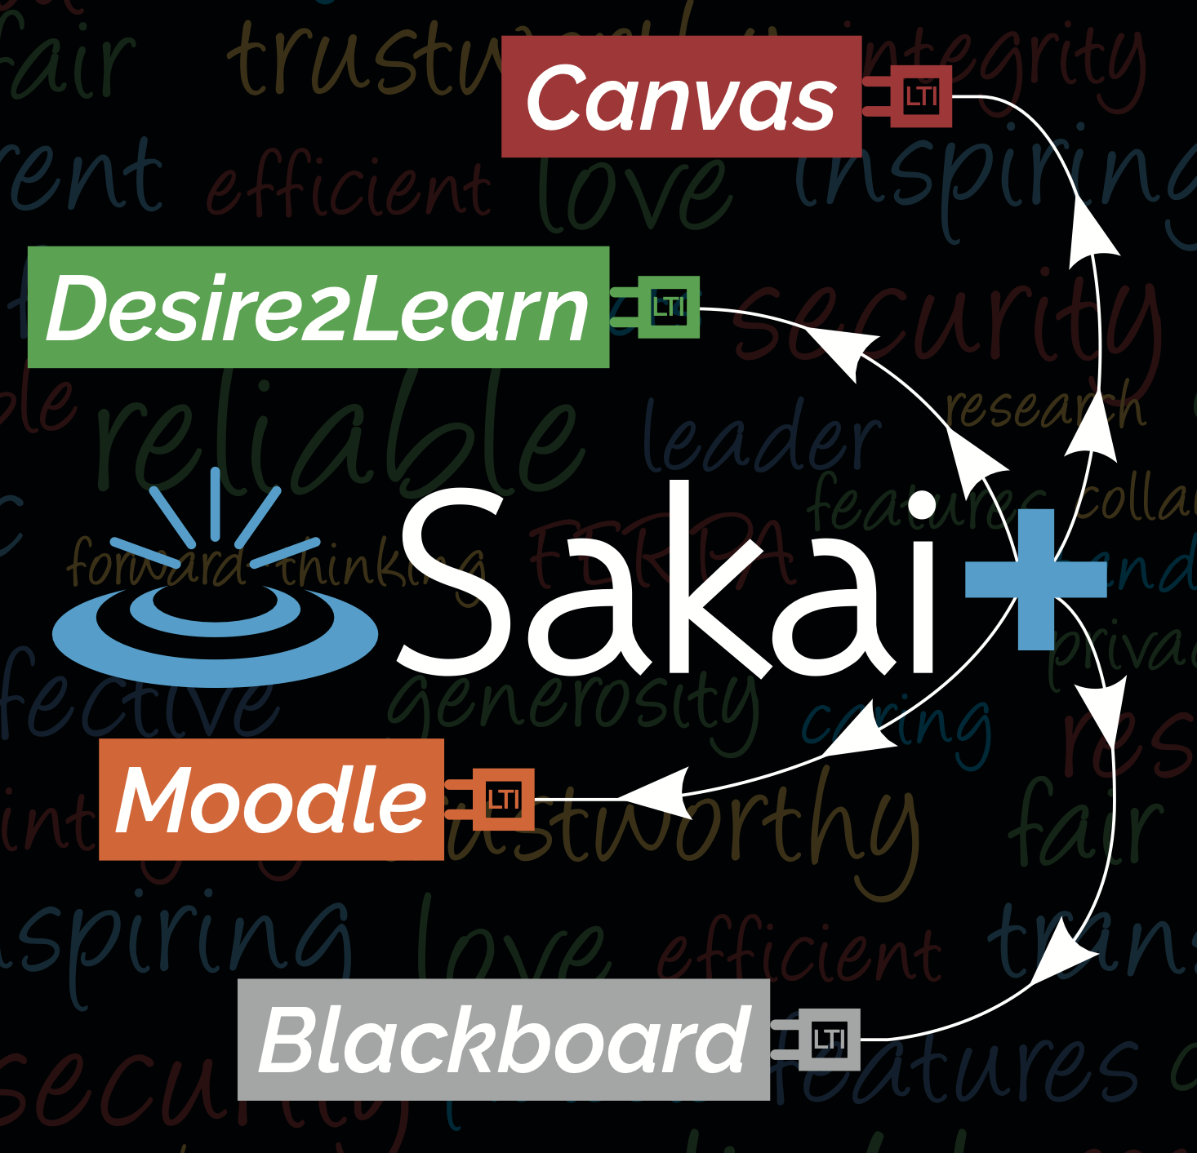
SakaiPlus TL;DR
Plugs an entire LMS into an Enterprise LMS with a single link
Rosters and Grades are synchronized using LTI Advantage
Cost and IT Support are on par with a single LTI Tool
Give your innovative faculty an LMS choice without switching the whole campus

Slide 3
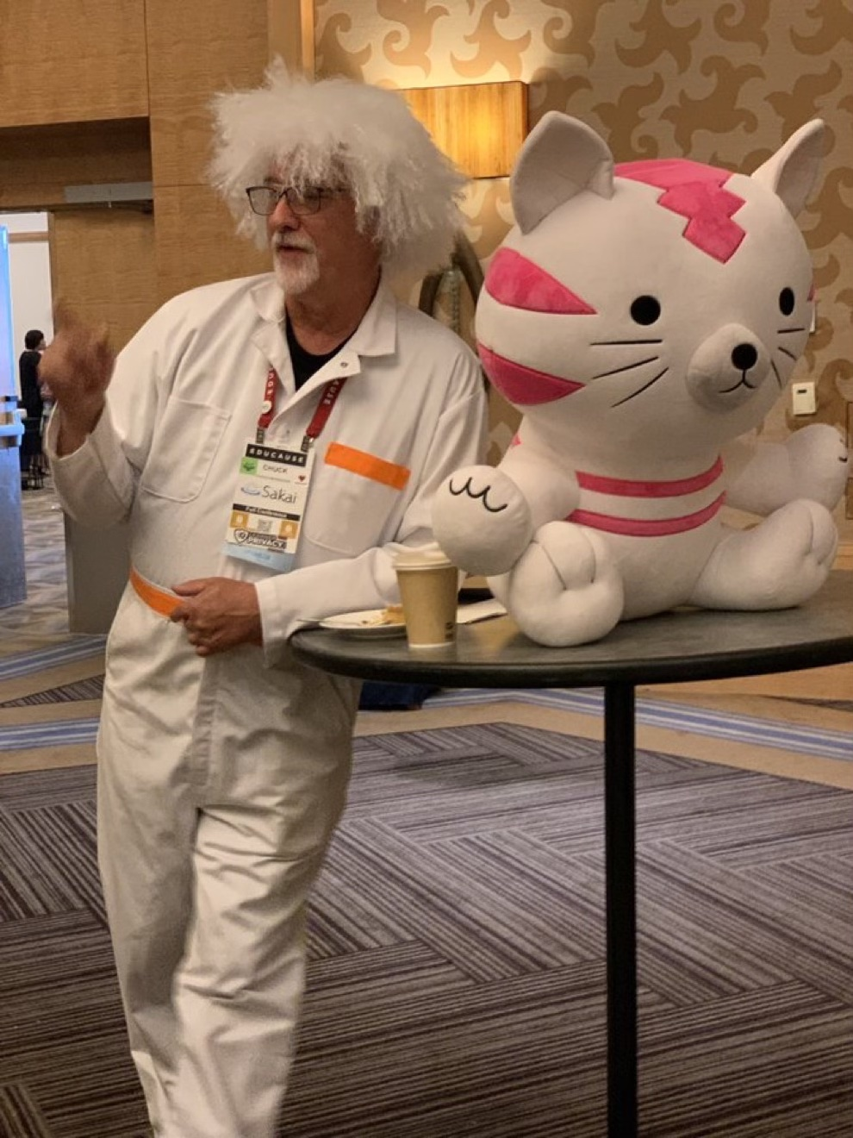
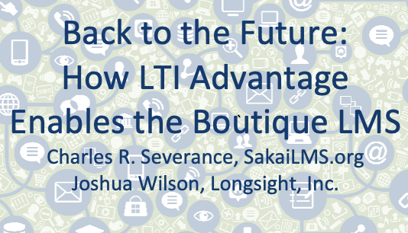
NERCOMP 2022

Slide 4



Innovation Conundrum
Most Faculty
Upload PowerPoint
Have some due dates
Don't move my cheese
Campus IT
Simplicity
Stability
Scalability
Cost
A Few Faculty
I have an idea...
I want to teach using...
Is there a feature that lets me..
Can we add a feature?
#NERCOMP22

Slide 5
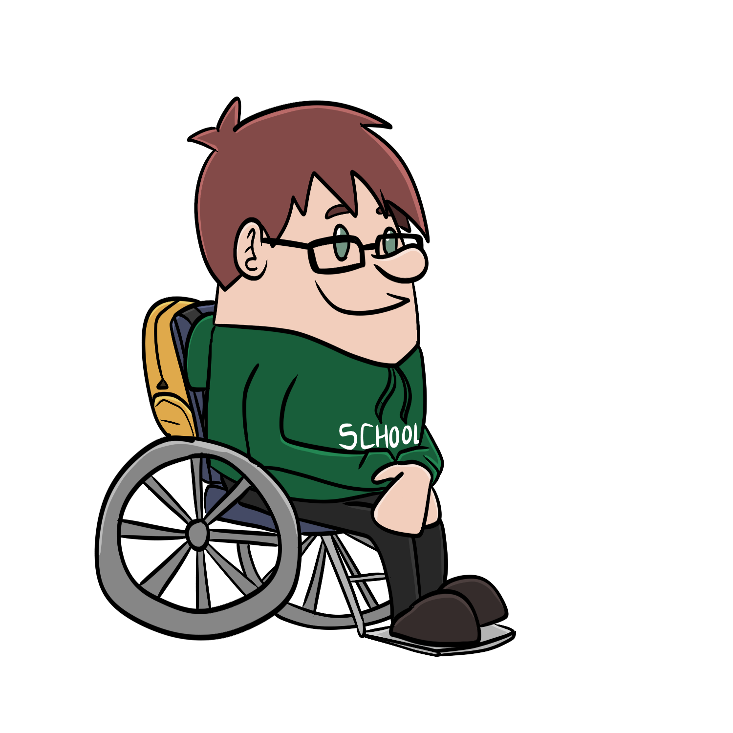



Student
Information
System
Canvas
Blackboard
Brightspace
...
LTI Advantage
SSO / Launch
Synchronized roster
Synchronized grades
Deep Linking
#NERCOMP22

Slide 6
Demo

Slide 7
The First Beta Test

Slide 8
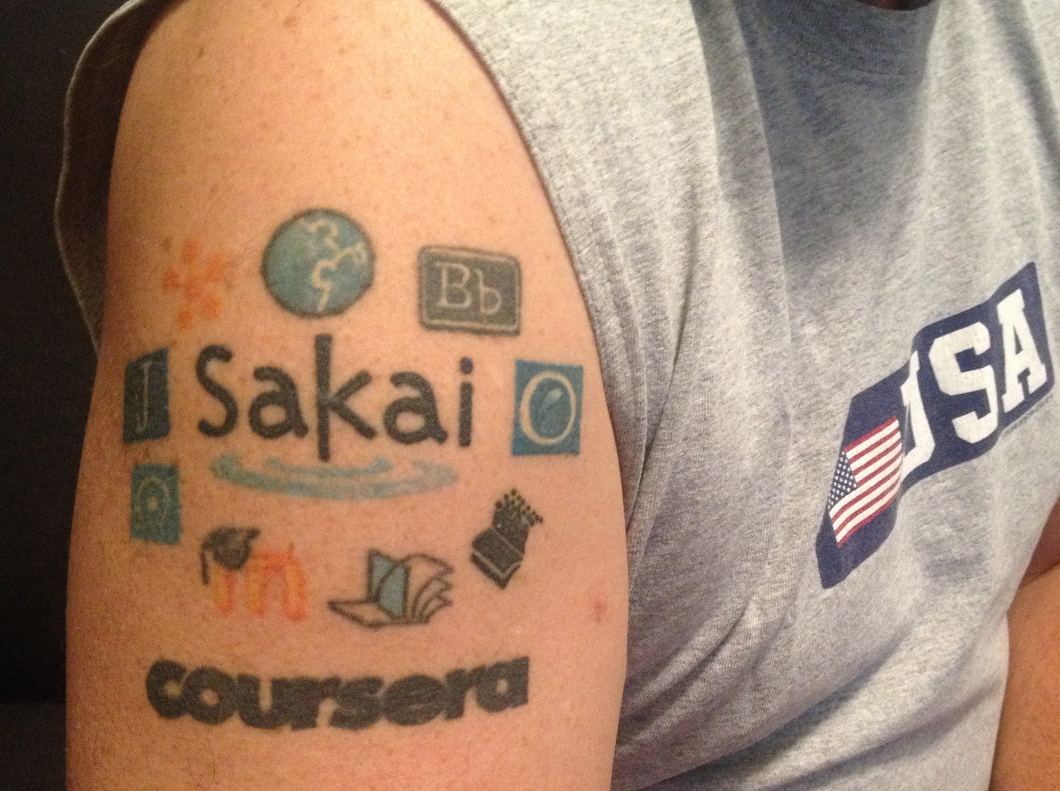
Dr. Chuck
Co-Founder Sakai 2004
Founded Learning Tools Interoperability (LTI) 2004
Founded Common Cartridge (2006)
Faculty member University of Michigan School of Information 2007-present
MOOC Innovator – Coursera 2014
Current Chair of the Sakai PMC

Slide 9
SakaiPlus @ University of Michigan
Initial Development and Testing – 2021
Summer 2022
Approval for limited production use in the School of Information
Privacy training
Hosted on UMich-owned AWS resources
Fall 22 – Sakai 22+Beta – One Course
Winter 23 – Sakai 23+Beta – Three Courses
Summer 2023 – Released in Sakai 23

Slide 10
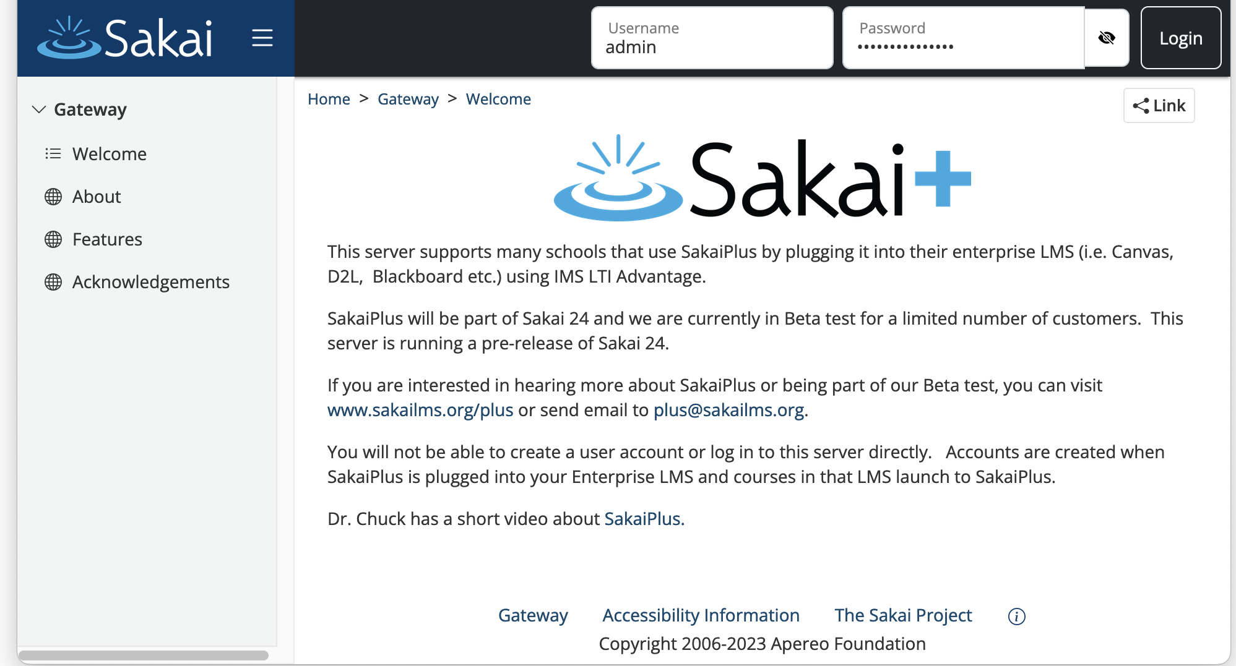
https://plus.sakaicloud.com – Beta Ready

Slide 11
SakaiPlus Philosphy
No local customization
Easy Upgrades
Deployent Choices
Cloud LTI Tool
AMI Subscription on locally owned hardware

Slide 12
Living inside the Enterprise LMS
Upgrading SakaiPlus is less impactful
Less concern regarding performance and scaling
No standup meetings ☺
Always can fall back to the enterprise LMS

Slide 13
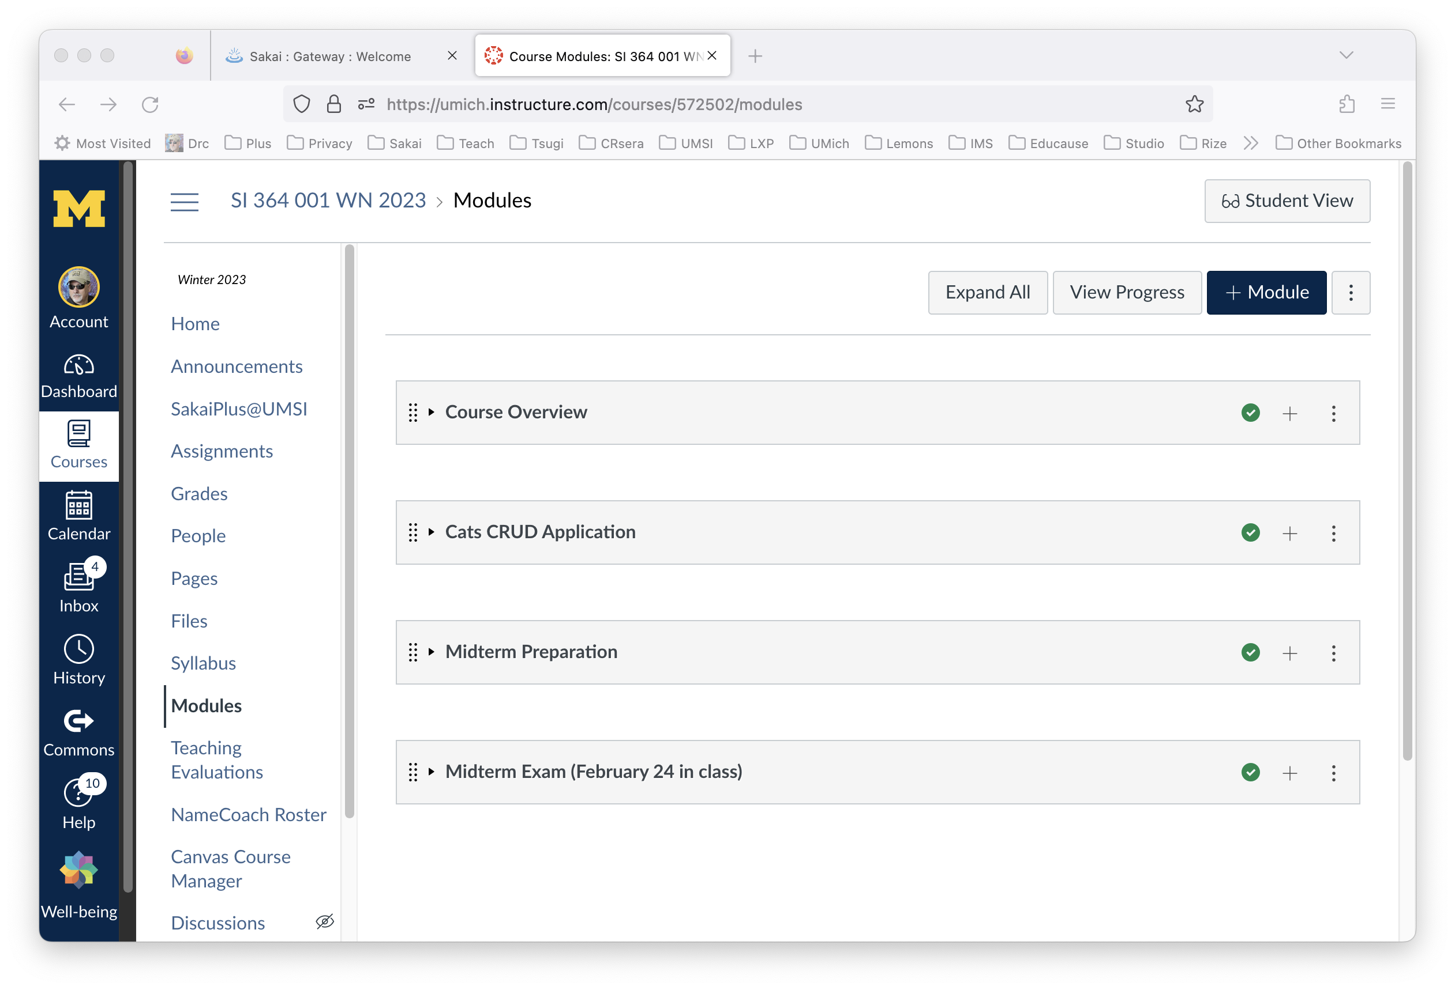
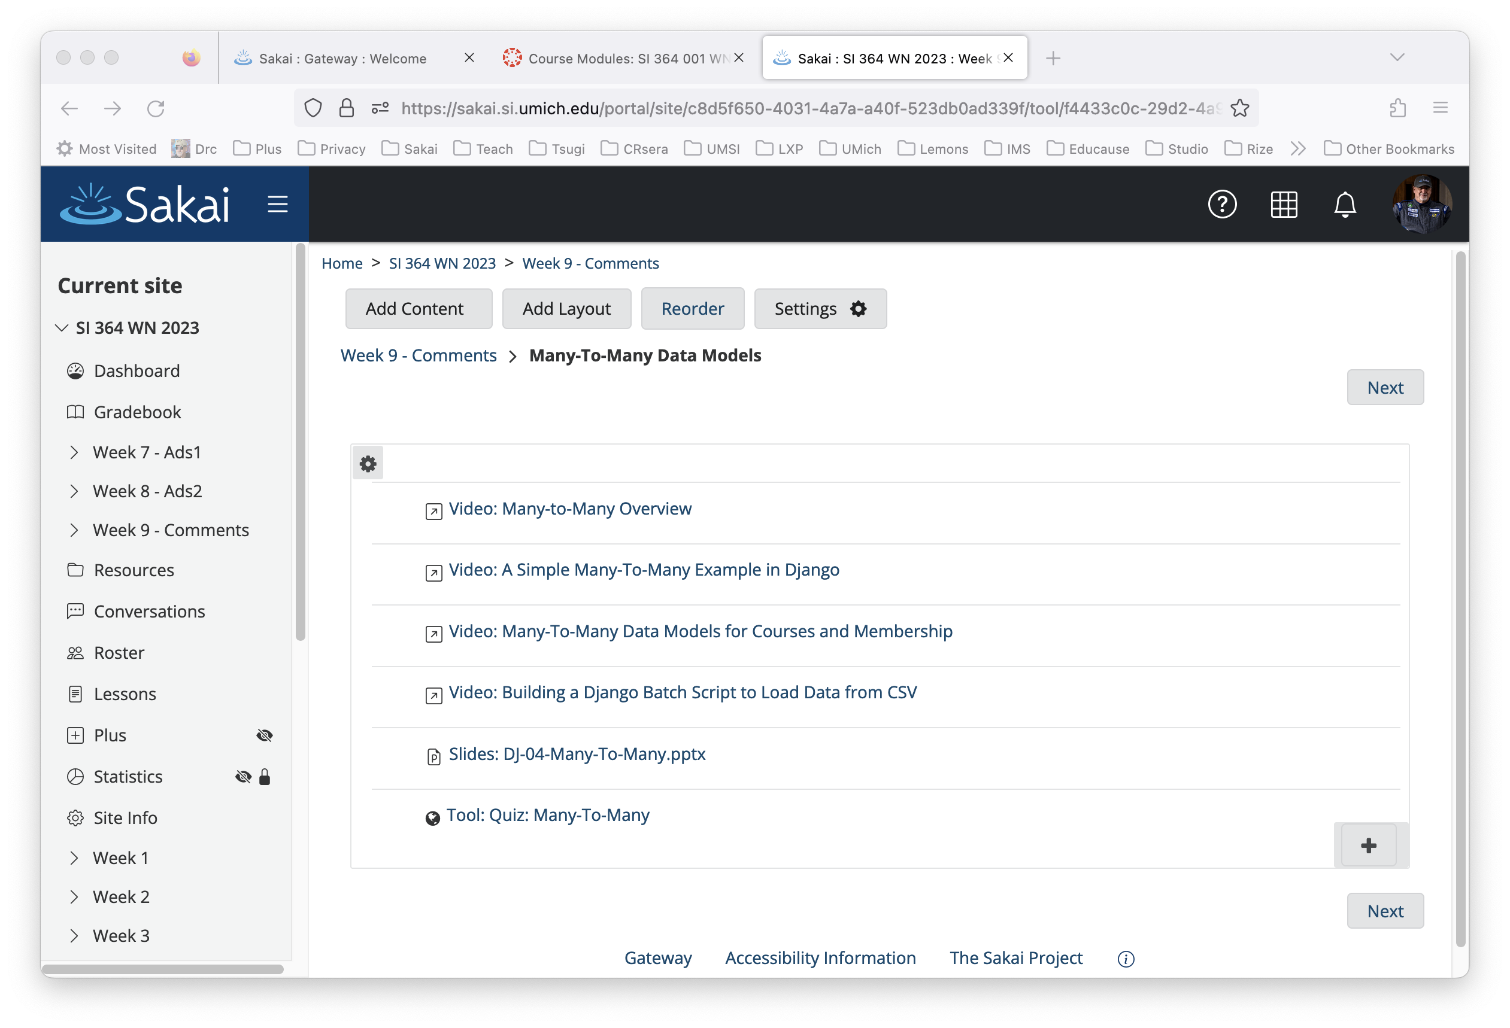

Slide 14
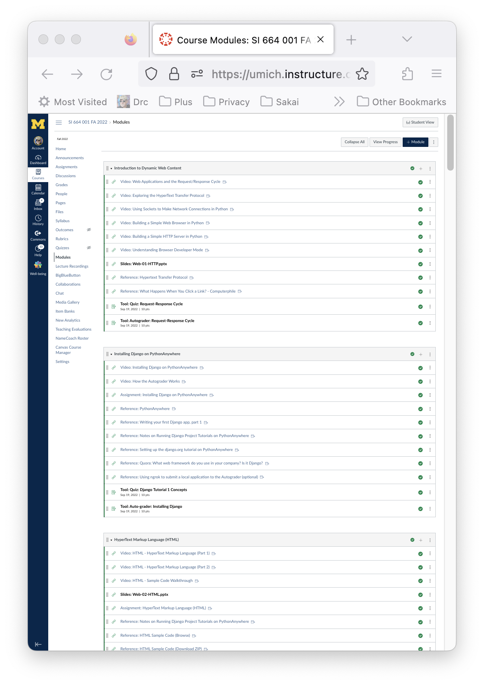
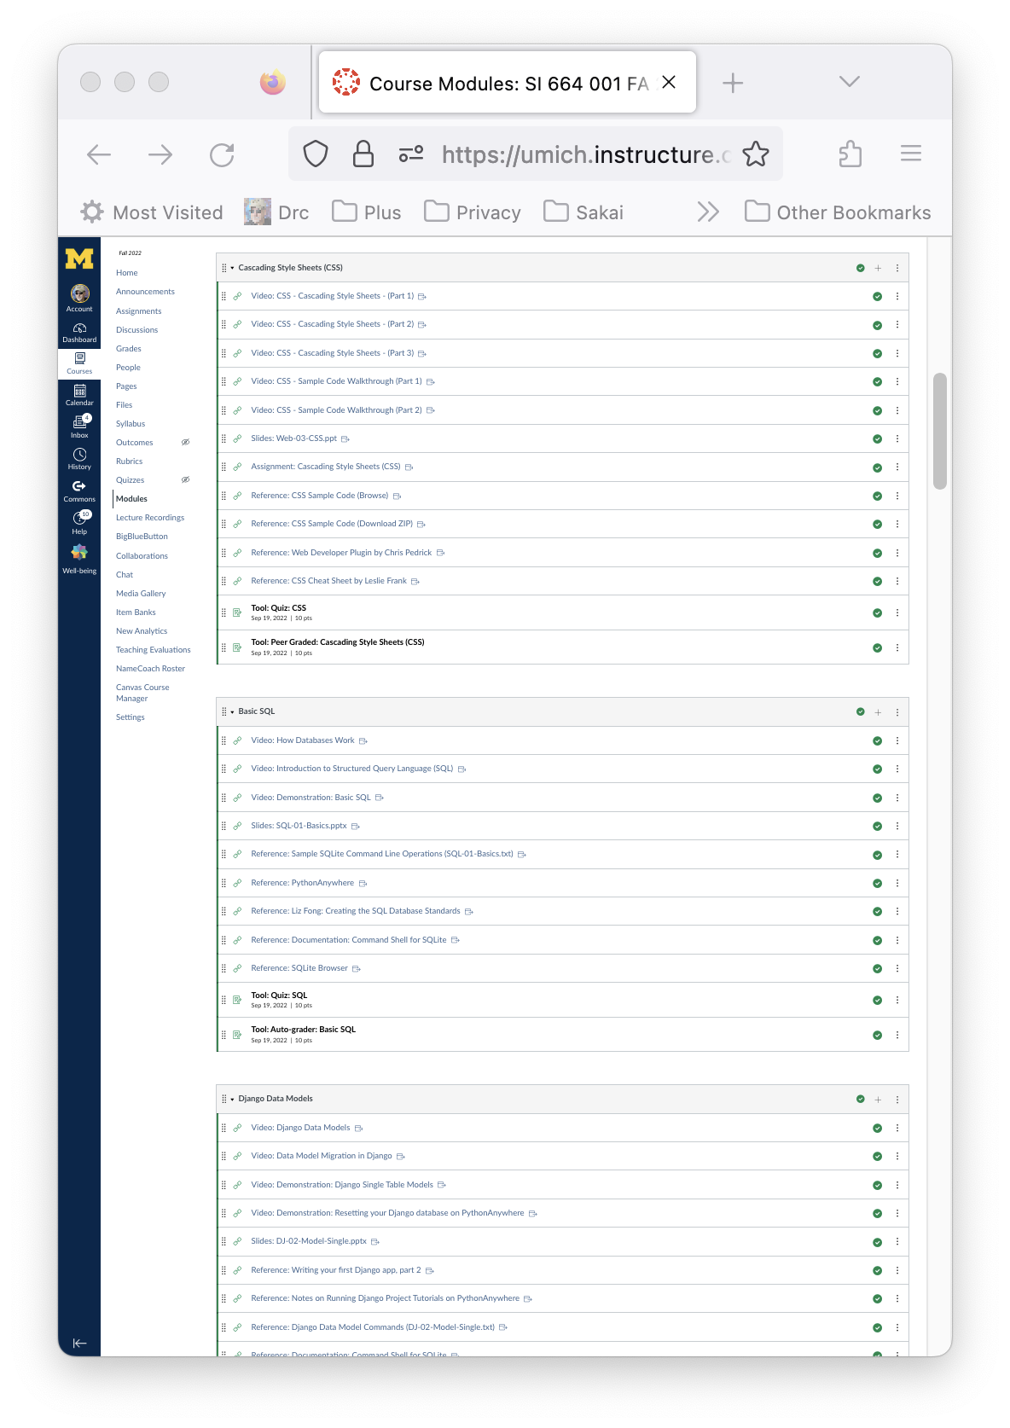
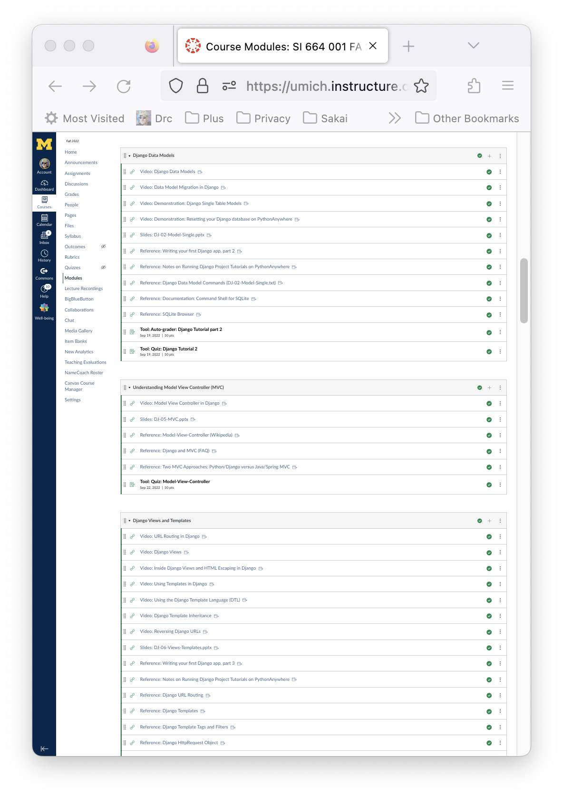
My Fall 22 Modules in Canvas (1/3)

Slide 15
Campus IT Perspective
From the Campus IT perspective, this is a single LTI tool
The "new vendor" meetings 3-4 hours Summer 2033
Help with the integration (1 hour back in Sept 2022)
Happy faculty member

Slide 16
Instructor Perspective
I am teaching the way I like
I have much more control over the student UX because of Sakai's Lessons
I feel like my approach to teaching can be "open ended"

Slide 17
Student Perspective
Zero complaints
Students picked it up right away
They use resources outside the LMS across many classes - this was like a publisher site associated with a book
They figured out and used Sakai features

Slide 18
Summary
More information
Plus @sakailms.org
Shipping – Sakai 23 – Summer 2023
Beta server
https://plus.sakaicloud.com
I am looking for some beta testers with D2L, Canvas, and Blackboard

